Slide 1

E-Commerce Website Using MERN Stack
Project Team:
Dudipala Laxmi Prasanna (1608-23-737-031)
Balaji Lakshmipathi (1608-23-737-033)
Gadi Rishanka (1608-23-737-035)
Guide: Ms. Vijayalaxmi | Department: Information Technology

Slide 2

Abstract:
E-commerce applications allow users to buy and sell products online through web platforms. The exponential rise in online shopping demands robust, scalable, and secure e-commerce web applications. This project aims to develop a modern e-commerce website using the MERN stack (MongoDB, Express.js, React.js, Node.js). The proposed system uniquely integrates standard product purchasing with innovative features such as a "Shared Cart" for collaborative shopping, a duration-based "Rental System," and a "Smart Budget Mode" that tracks spending and sends intelligent alerts.

Slide 3




Basic Idea & Features
A MERN stack-based e-commerce website integrating:
Product Purchasing
Shared Cart
A complete buying experience with secure transactions.
Collaborative shopping with group invitations.
Rental System
Budget Mode
A flexible, duration-based product rental system.
Smart tracking with intelligent alerts.

Slide 4

Problem Definition
Existing Problems
Why a Solution Is Needed
No shared cart for group shopping
Rental services fragmented across separate platforms
Lack of built-in smart budget tracking tools
Missing alerts leading to unintended overspending
A unified system is required to integrate the following features into a single, scalable platform:
Buying and renting capabilities
Collaborative shopping experience
Intelligent budget management

Slide 5



System Architecture and Design:
System Architecture
React.js Frontend
Browser UI handling user interactions and routing
Node.js & Express
API layer handling requests, authentication, and business logic
MongoDB Database
Persistent storage for users, products, and orders

Slide 6
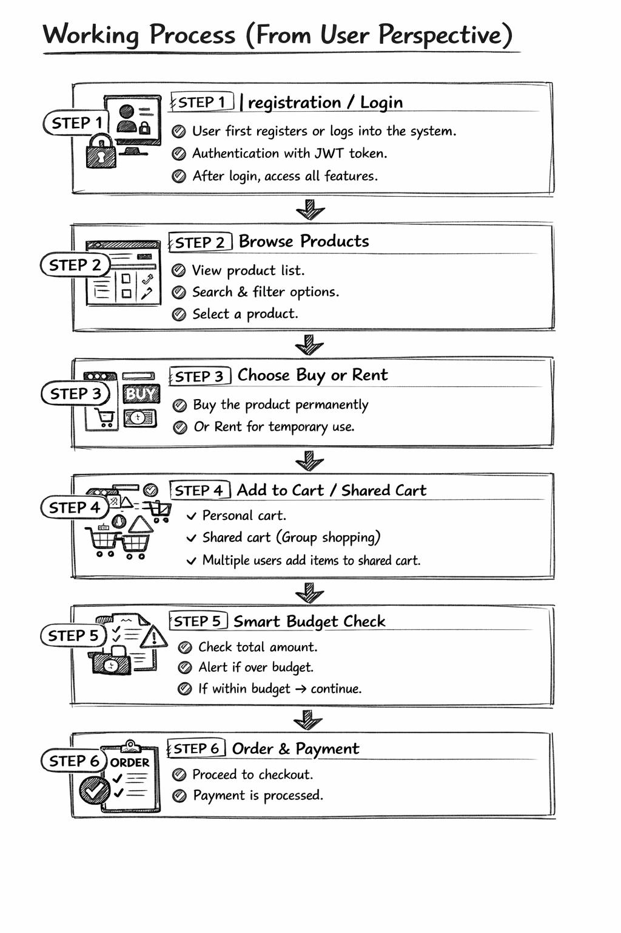
Methodology and Module-wise
Explanation:
Methodology:
The project follows:
1. Requirement Analysis
2. UI Design
3. Database Design
4. Backend Development
5. Testing
6. Deployment
Working Process
Phase 1: User Engagement
Phase 2: Order Processing
User registration and login
JWT token authentication
Browsing and searching products
Adding to cart or shared cart
Selection: Buy or Rent
Budget check and alerts
Payment processing
Database persistence

Slide 7
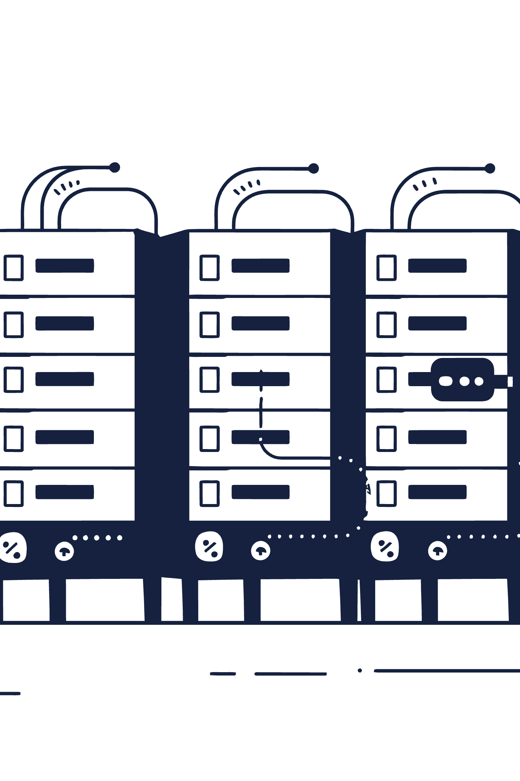
Tools & Technologies
Programming Languages
HTML5, CSS3, JavaScript
Libraries & Frameworks
React.js, Node.js, Express.js, Mongoose, JWT
Software Tools
VS Code, Postman, MongoDB Atlas, GitHub
Hardware Requirements
4GB RAM (minimum), Windows/Linux OS

Slide 8
Implementation Progress and Demonstration:
Phase 1: Research
Phase 3: Implementation
Literature review, requirement analysis
Backend API development
Frontend development
Shared cart & rental module
Smart budget logic
1
2
3
4
Phase 2: Design
Phase 4: Testing
Architecture design, database schema
Unit testing
Integration testing
Bug fixing
Deployment

Slide 9
Database/Dataset Design:
The database is hosted on MongoDB Atlas, providing scalable and document-based cloud storage.
Collections Used:
Users:
Stores user profile details, email, password, and authentication information.
Products:
Contains product name, category, pricing, stock availability, and product images.
Carts:
Stores items added to cart, quantity, and shared cart access between users.
Orders:
Maintains order history, payment details, and order status.
Budgets:
Tracks user spending limits and smart budget alerts.

Slide 10
Results,Outputs and Analysis
Results
Successfully developed a responsive e-commerce website
Users can easily browse and purchase products
Cart and checkout system works efficiently
Outputs
Faster shopping experience
User-friendly interface
Better product organization
Analysis
The system improves:
Shopping convenience
Product accessibility
Budget-friendly shopping experience

Slide 11
Challenges Faced and Solutions:
Challenge 1: Real-Time Synchronization for Shared Carts.
Solution: Implementing WebSockets (e.g., Socket.io) alongside standard REST APIs to ensure that when one user adds an item to a shared cart, it instantly reflects on the screens of all invited group members.
Challenge 2: Complex Checkout Logic (Mixing Rentals and Purchases).
Solution: Restructuring the database schema and cart logic to clearly flag items as type: 'buy' or type: 'rent', ensuring duration calculations only apply to rental items during the final checkout calculation.
Challenge 3: Implementing Intelligent Budget Alerts without Degrading Performance.
Solution: Handling budget calculations asynchronously on the backend before the final checkout step, ensuring the frontend UI remains responsive while the server verifies limits against the database.

